Slide 1
Image Compressor
A Windows Application...

Slide 2
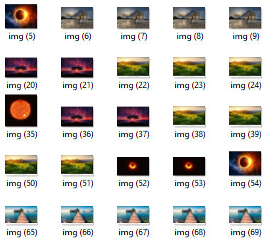
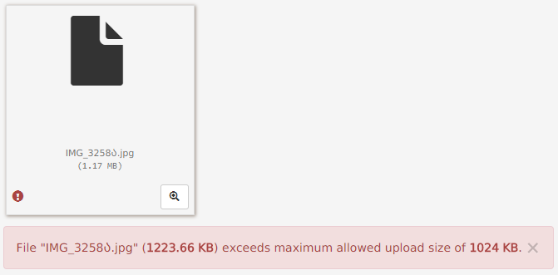
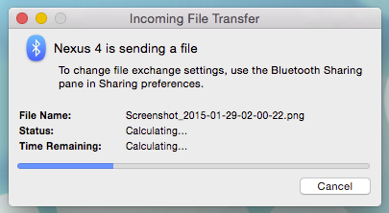

Why ?
Huge collection of image
Transfer of image

Slide 3
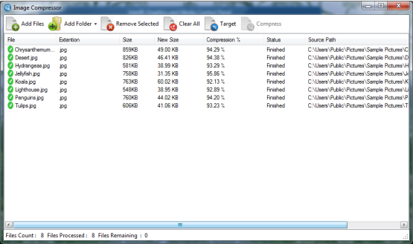
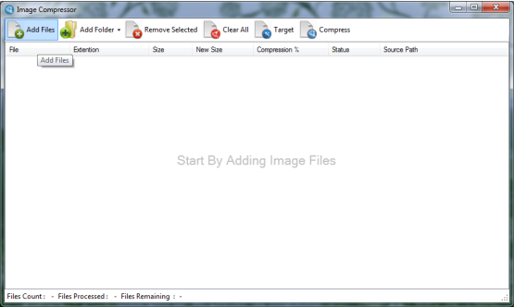
How ?

Slide 4
Features !
All Image file types are accepted
Users can add or remove images as per their needs
Users can set the quality in which images to be compressed (more the quality more the compression will happen)
Users can perform more than 100% compression
Software prevents itself from reverse engineering

Slide 5
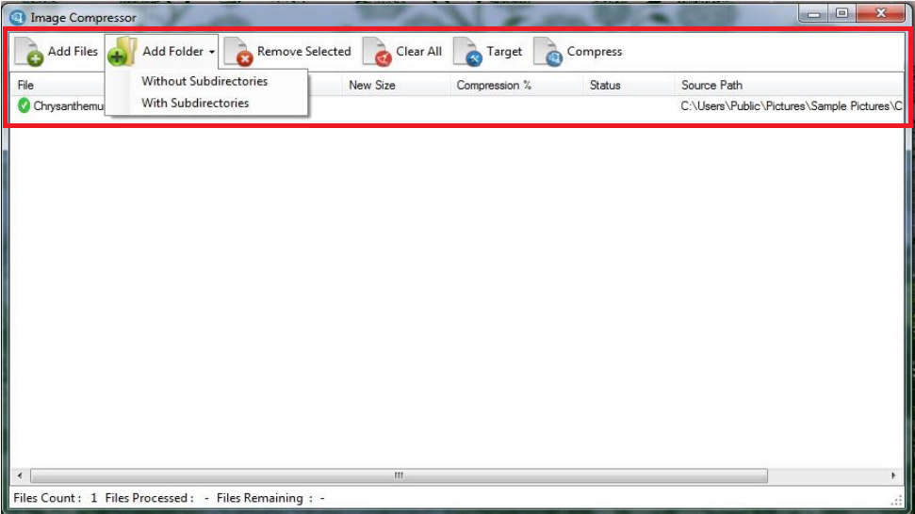
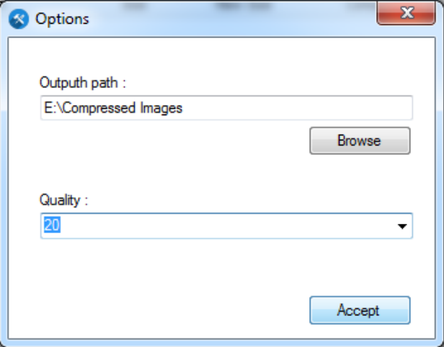
Tool Baar !

Slide 6
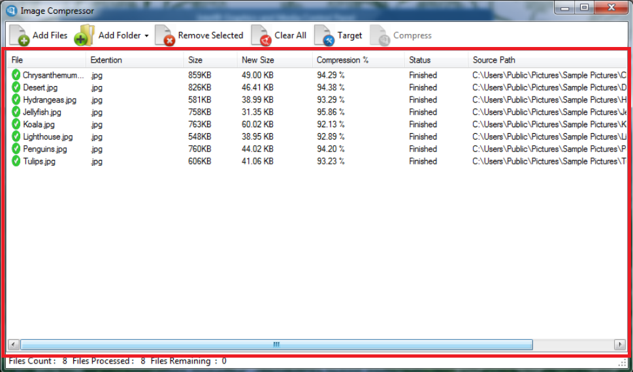
Display Area !

Slide 7
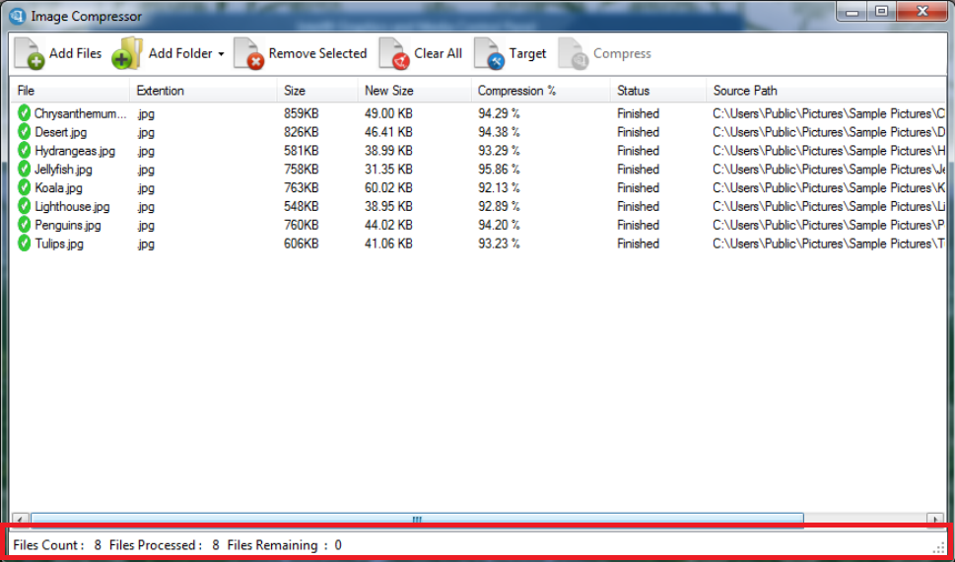
Status Bar !

Slide 8
Development Requirements !
Hardware Requirements:
PC / Laptop
Processor: above Intel Core i3
RAM: 4GB
Hard Disk: 500GB
Software Requirements:
Windows 8 or above
Visual Studio 2015 Community
Confuser
.Net Reflector
Inno Setup

Slide 9
Operating Requirements !
Hardware Requirements:
PC / Laptop
Processor: Any available
RAM: Any available
Hard Disk: Any available
Software Requirements:
Any windows operating system
.Net framework 4 or above

Slide 10
Limitations !
Icon files (.ico) files are not supported
Each time compression completes, users need to restart the application for other compressions

